Slide 1



CLOUD COMPUTING ARCHITECTURE
PRESENTED TO
Avita Katal Assistant Professor
Systemics
PRESENTED BY
Pratham Kandari
ASSIGNMENT (SAAS Application)
Team Name
CodeStalker

Slide 2





A Web Application For Uttarakhand Police

Slide 3
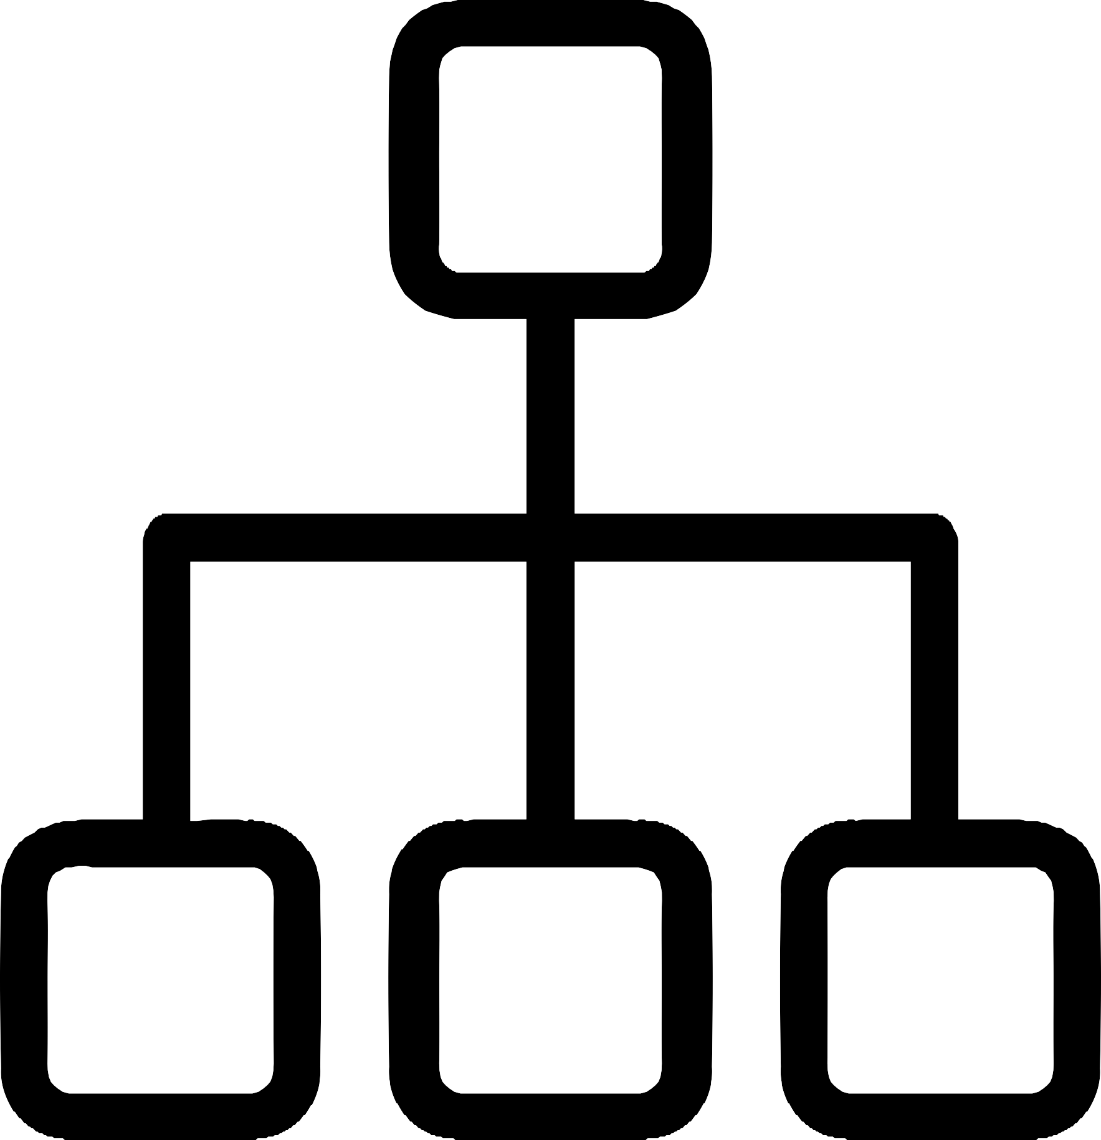
SAAS
Application
SAAS
Frontend
Backend
Features

Slide 4

Software Requirement Specification
Introduction:
Purpose
The purpose of this web application is to provide an online platform for Uttarakhand Police to better manage their operations and improve communication with the public for the betterment of the society. This web application will provide access to a range of features and tools to help police officers perform their duties more effectively.
Project Scope
This project will be a prototype for the Uttarakhand Police. If anyone sees a crime and want to file a FRI against it. He/ She can directly visit the web app on any browser. A web application is much preferred since it is more accessible and more convenient to the users and all the user required is just an Internet Connection.
One has to login through Aadhar Id and Phone Number then an image or video is required for the confirmation of a crime so that police officers can take action against it. Once the web application will be deployed successfully then I'll try to bring an Application for more easiness of users.

Slide 5

2. Functional Requirements:
The following are the functional requirements for this web application:
User Management: The web application should provide a user management system to allow police officers to create and manage their profiles. The system should also provide role-based
access control to ensure that users can only access the features and resources they are authorized to use.
Incident Management: The web application should allow police officers to report and manage
incidents such as crimes, accidents, and other emergencies. The system should provide a form to capture incident details, including the location, type of incident, and any additional information needed.
Crime Statistics: The web application should provide access to crime statistics to help police
officers analyze and track crime trends over time. The system should allow users to filter the data by location, date range, and type of crime.
Resource Management: The web application should allow police officers to manage and share
resources such as vehicles, equipment, and personnel. The system should provide a calendar view to show the availability of resources and allow officers to reserve resources as needed.
Communication: The web application should provide a communication platform to allow police officers to communicate with each other and with the public. The system should include messaging
features, both within the application and through external channels like email and SMS.

Slide 6


f. Reporting: The web application should provide reporting features to allow police officers to generate reports on incidents, resources, and other data. The system should include a range of pre-built report templates as well as the
ability to create custom reports.
3. Non-Functional Requirements:
The following are the non-functional requirements for this web application:
Security: The web application should be secure, with appropriate measures in place to protect user data and prevent unauthorized access. The system should use encryption to protect sensitive information, and should provide strong password
policies and two-factor authentication.
Performance: The web application should be fast and responsive, with minimal load times and high availability. The system should be able to handle large amounts of data and traffic without slowing down or crashing.
Scalability: The web application should be scalable, with the ability to handle increasing amounts of data and traffic as the user base grows. The system should be designed to scale horizontally or vertically as needed.
Accessibility: The web application should be accessible to users with disabilities, including those who use assistive technologies like screen readers. The system should comply with accessibility standards such as WCAG 2.1 to ensure that
all users can access the application.

Slide 7


Technology Stack Used in the Project

Slide 8

HTML
HTML (Hypertext Markup Language) is a markup language used to create and design web pages. It is the standard language used for creating documents on the World Wide Web. HTML allows web developers to define the structure and content of a web page, including text, images, videos, and hyperlinks.
HTML consists of a series of tags and attributes, which are used to specify the various elements of a web page. For example, the <head> tag is used to define the header section of a web page, while the <p> tag is used to define paragraphs of text.
When a user visits a web page, the web browser uses the HTML code to render the page in a format that can be read and interacted with. HTML is often used in conjunction with other web development technologies like CSS and JavaScript to create more complex and interactive web pages.

Slide 9

CSS
CSS stands for Cascading Style Sheets. It is a styling language used to describe the presentation of a document written in HTML (Hypertext Markup Language) or XML (Extensible Markup Language).
CSS allows developers to define how elements on a web page should look and be laid out. This includes things like fonts, colors, sizes, spacing, and positioning of elements. By separating the presentation from the content, CSS enables developers to create consistent designs across multiple pages and easily make changes to the visual appearance of a site.
CSS operates on a cascading system, which means that the styles applied to an element can be influenced by several factors, including the element's own styles, the styles of its parent elements, and any styles defined in an external stylesheet. This cascading system allows developers to create flexible and responsive designs that can adapt to different screen sizes and devices.

Slide 10

JS
JS stands for JavaScript. It is a high-level, interpreted programming language used to create interactive and dynamic websites.
JavaScript can be used for a variety of purposes, including adding interactivity to web pages, creating animations and visual effects, building web and mobile applications, and creating server-side applications. It is a versatile language that is used in both front-end and back-end development.
JavaScript is often used in conjunction with HTML and CSS to create dynamic and responsive websites. It is supported by all major web browsers and is an essential part of modern web development.
JavaScript is a client-side scripting language, which means that it runs in the user's web browser rather than on the server. This allows for dynamic updates and changes to be made to a web page without the need for a full page refresh. Additionally, JavaScript can interact with other web technologies, such as APIs and databases, to create more complex and powerful applications.

Slide 11

MongoDB
MongoDB is a popular, open-source NoSQL database management system. It is designed to handle unstructured and semi-structured data, making it an ideal choice for big data and real-time applications.
Unlike traditional SQL databases, which use tables and a strict schema to organize data, MongoDB stores data in flexible, JSON-like documents. This makes it easier to store and manage large volumes of data, as well as to update and modify data structures on the fly.
MongoDB is also known for its scalability, high availability, and automatic sharding, which allows data to be distributed across multiple servers for improved performance and reliability. It supports a wide range of programming languages and has a robust set of features, including full-text search, aggregation, and geospatial indexing.
MongoDB is widely used in a variety of industries and applications, including e- commerce, healthcare, finance, social media, and more. Its flexibility and scalability make it a popular choice for both small and large organizations looking to manage and analyze large volumes of data.

Slide 12

Firebase
Firebase is a mobile and web application development platform that provides a suite of tools and services to help developers build and deploy high-quality applications quickly and easily. It is owned by Google and is a popular choice for building real-time applications and backend services.
Firebase provides a range of services, including real-time database, authentication, hosting, cloud messaging, and more. Its real-time database allows developers to store and synchronize data in real-time across multiple devices, while its authentication service provides secure user authentication and authorization. Firebase also offers cloud messaging for sending notifications and messages to users, as well as hosting for web applications.
One of the key benefits of Firebase is that it provides a complete backend solution, eliminating the need for developers to build and maintain their own backend servers. This can save time and resources, allowing developers to focus on building the frontend of their application. Additionally, Firebase provides a range of tools for monitoring and analyzing app usage, allowing developers to gain insights into how their app is being used and identify areas for improvement.

Slide 13
ReactJS
ReactJS is a popular, open-source JavaScript library used for building user interfaces for web and mobile applications. It was developed by Facebook and is now maintained by a community of developers.
ReactJS uses a component-based architecture, allowing developers to build reusable UI components and compose them to create complex user interfaces. It also utilizes a virtual DOM (Document Object Model), which allows it to efficiently update and render changes to the UI without requiring a full page reload.
One of the key benefits of ReactJS is its ability to handle large and complex applications with ease. It allows for modular code, making it easy to maintain and scale applications over time. It is also highly flexible, allowing developers to integrate it with a wide range of other libraries and frameworks.
ReactJS is widely used in the industry and has a large and active community of developers, providing a wealth of resources and support. It is used by many popular websites and applications, including Facebook, Instagram, Netflix, and Airbnb.

Slide 14


AWS Cloudwatch
AWS CloudWatch is a monitoring and logging service provided by Amazon Web Services (AWS) for cloud resources and applications running on AWS. It enables developers and system administrators to monitor and collect metrics, collect and view log files, and set alarms and triggers for their applications and infrastructure running on AWS.
CloudWatch can collect data from various AWS services such as Amazon EC2, Amazon RDS, AWS Lambda, and others, as well as custom applications running on Amazon EC2 instances.
The collected data can be used to monitor resource utilization, troubleshoot operational issues, and improve performance.
CloudWatch provides real-time monitoring and automated alerting, allowing users to set up alarms based on custom metrics and thresholds. It can also be used to monitor and analyze logs generated by applications running on AWS, making it easier to troubleshoot issues and identify patterns in application behavior.
In addition to monitoring and logging, CloudWatch also provides other features such as dashboards, API calls, and integrations with other AWS services. It is a key tool for maintaining the availability and performance of applications and infrastructure running on AWS.

Slide 15
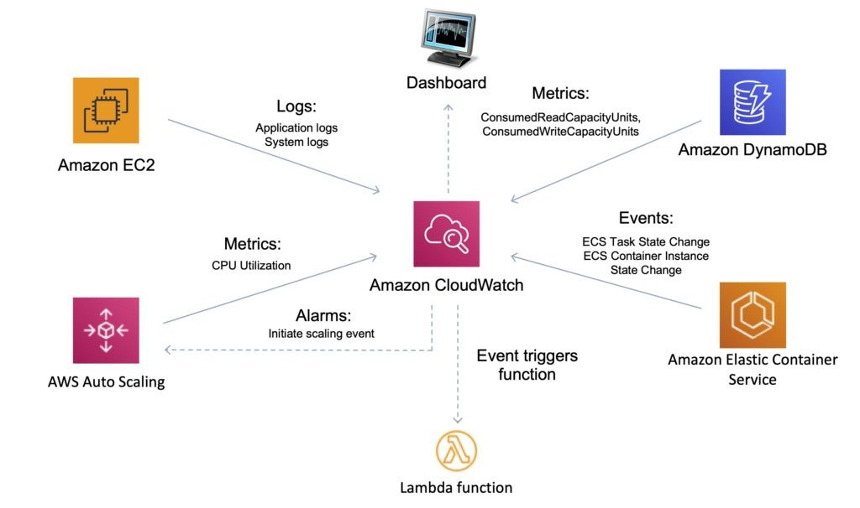

Slide 16


AWS Deployment Models
The models are: AWS CloudDeploy
AWS Elastic Beanstalk AWS CloudFormation
AWS Serverless Application Model AWS CodePipeline
AWS OpsWorks
These AWS Deployment Services help developers to automate and streamline the deployment and management of their applications, making it easier to scale and maintain their systems.

Slide 17

Current Status of the Project
Currently I'm working on the dataset of the project as it would be having a huge amount of data. Data of all the Police Stations has to be taken out. Maps have to be inserted in the application to track the exact location of the
crime.

Slide 18

GitHub- URL
Here is my GitHub URL to view the project source code
https://github.com/prathamkandari/CCA-Project

